Slide 1
Variational Interaction Information Maximization for Cross-domain Disentanglement Accepted in NeurIPs 2020
Kyeong Ryeol, Go
M.S. Candidate of OSI Lab

Slide 2
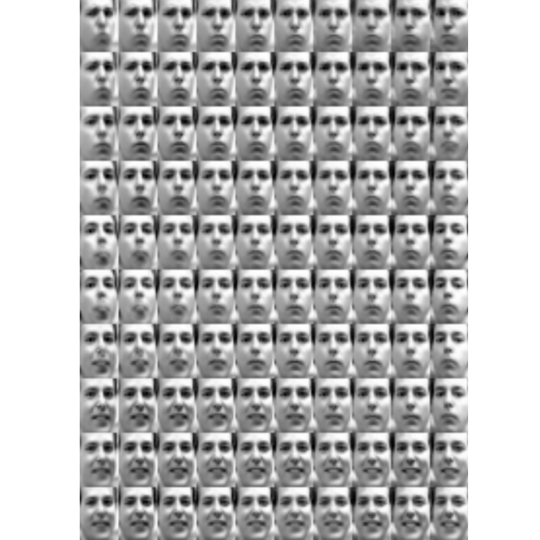
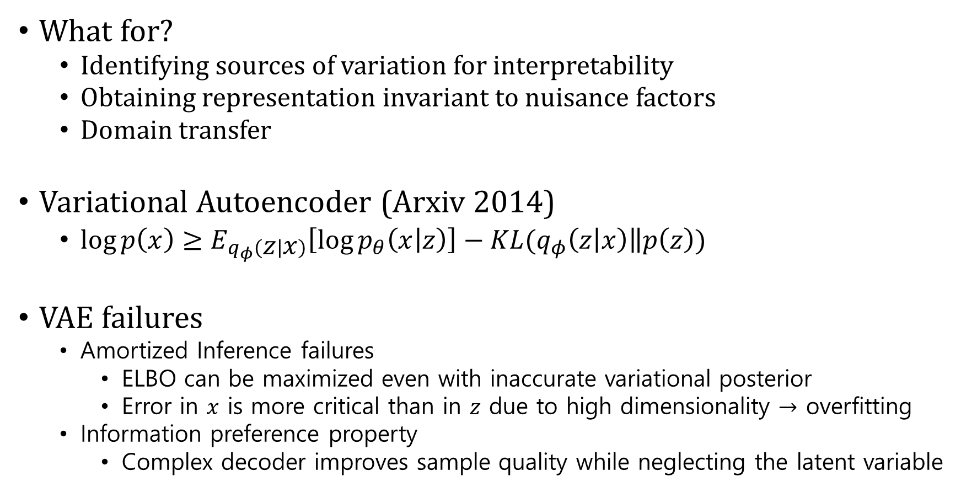
Disentanglement
What for?
Identifying sources of variation for interpretability
Obtaining representation invariant to nuisance factors
Domain transfer
Variational Autoencoder (Arxiv 2014)
$\log{p\left(x\right)}≥E_{q_{φ}\left(z | x\right)}\left[\log{p_{θ}\left(x | z\right)}\right]−KL(q_{φ}\left(z | x\right)\left\|p\left(z\right)\right.)$
VAE failures
Amortized Inference failures
ELBO can be maximized even with inaccurate variational posterior
Error in $x$ is more critical than in $z$ due to high dimensionality $→$ overfitting
Information preference property
Complex decoder improves sample quality while neglecting the latent variable
Reconstruction term
Compression term

Slide 3
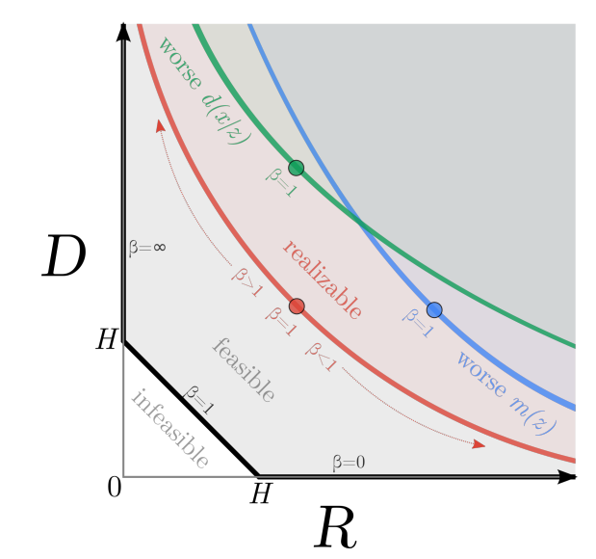
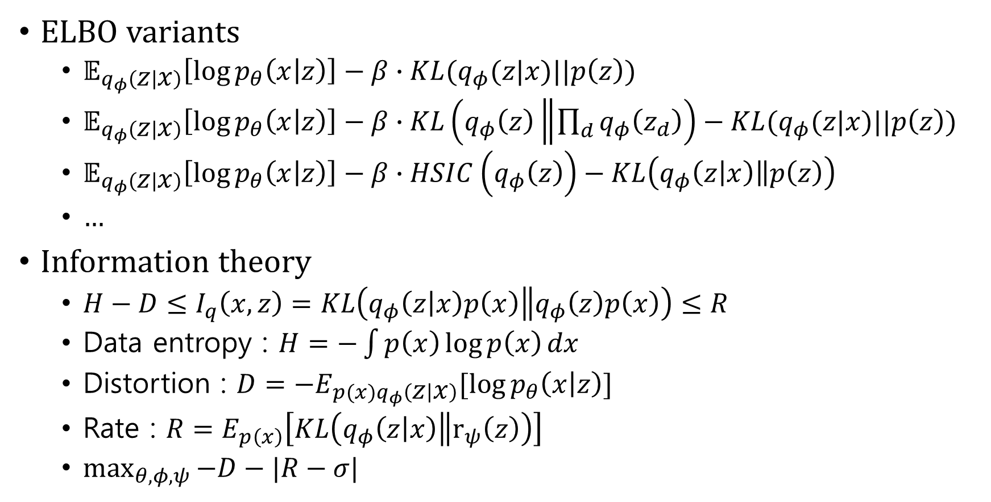
Disentanglement
ELBO variants
$𝔼_{q_{φ}\left(z | x\right)}\left[\log{p_{θ}\left(x | z\right)}\right]−β∙KL(q_{φ}(z|x)||p\left(z\right))$
$𝔼_{q_{φ}\left(z | x\right)}\left[\log{p_{θ}\left(x | z\right)}\right]−β∙KL\left(q_{φ}\left(z\right)\left\|\prod_{d}{q_{φ}\left(z_{d}\right)}\right.\right)−KL(q_{φ}(z|x)||p\left(z\right))$
$𝔼_{q_{φ}\left(z | x\right)}\left[\log{p_{θ}\left(x | z\right)}\right]−β∙HSIC\left(q_{φ}\left(z\right)\right)−KL\left(q_{φ}\left(z | x\right)\left\|p\left(z\right)\right.\right)$
…
Information theory
$H−D≤I_{q}\left(x,z\right)=KL\left(q_{φ}\left(z | x\right)p\left(x\right)\left\|q_{φ}\left(z\right)p\left(x\right)\right.\right)≤R$
Data entropy : $H=−\int{p\left(x\right)\log{p\left(x\right)}}dx$
Distortion : $D=−E_{p(x)q_{φ}\left(z | x\right)}[\log{p_{θ}\left(x | z\right)]}$
Rate : $R=E_{p\left(x\right)}\left[KL\left(q_{φ}\left(z | x\right)\left\|r_{ψ}\left(z\right)\right.\right)\right]$
$\max_{θ,φ,ψ}{−D−|R−σ|}$

Slide 4
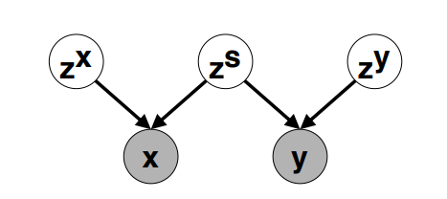
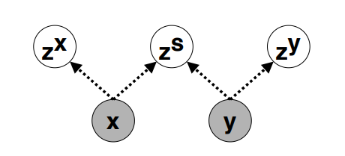
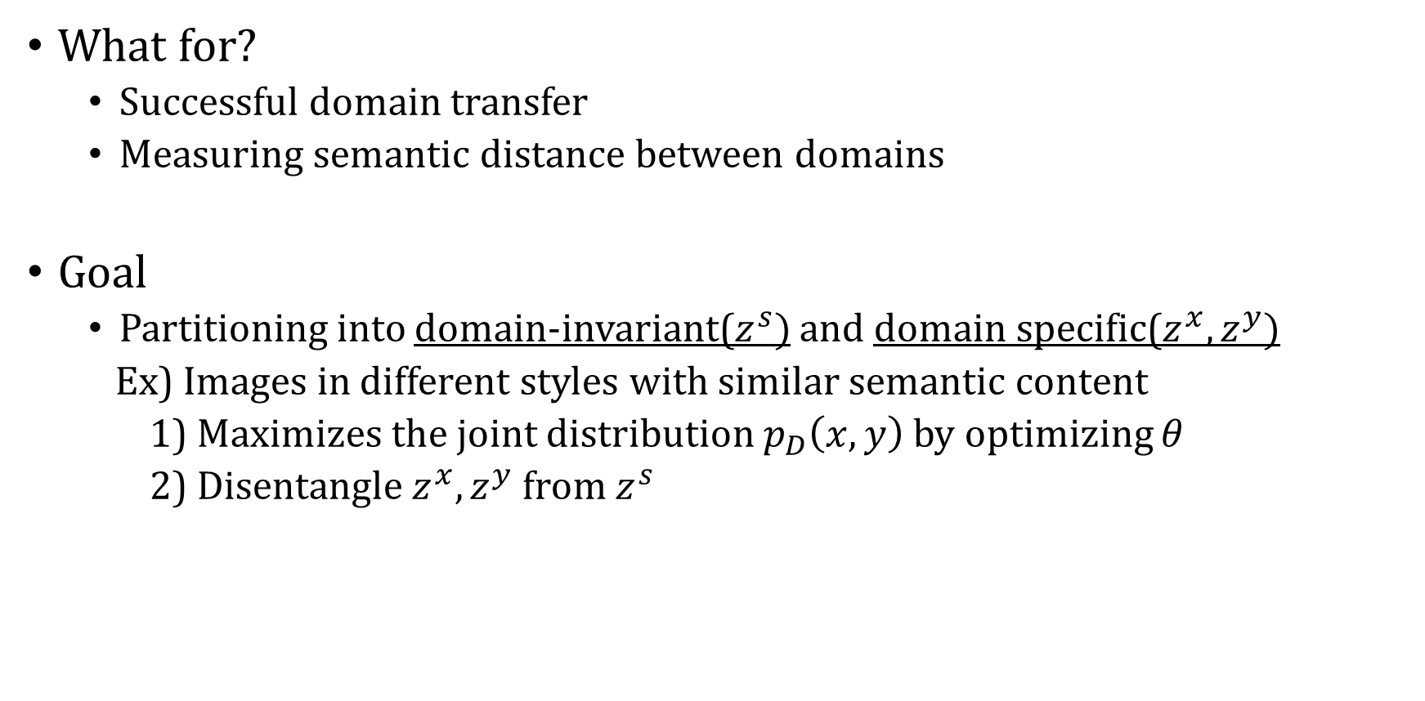
Cross domain disentanglement
What for?
Successful domain transfer
Measuring semantic distance between domains
Goal
Partitioning into domain-invariant($z^{s})$ and domain specific($z^{x}, z^{y})$
Ex) Images in different styles with similar semantic content
1) Maximizes the joint distribution $p_{D}\left(x,y\right)$ by optimizing $θ$
2) Disentangle $z^{x}, z^{y}$ from $z^{s}$

Slide 5
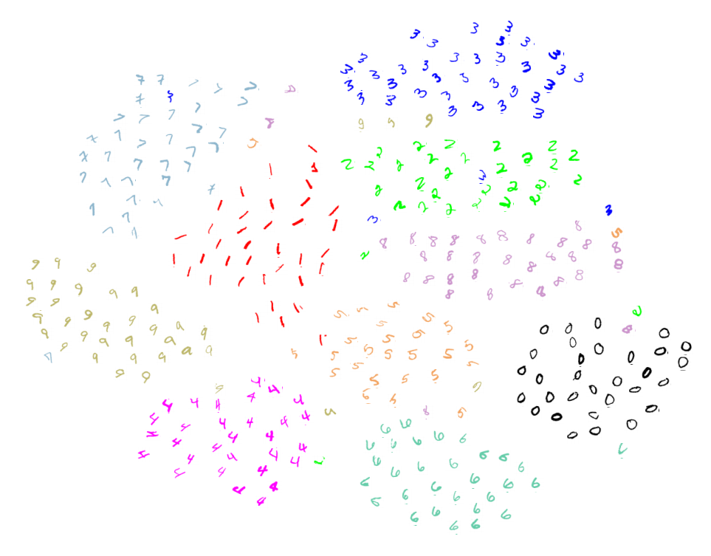
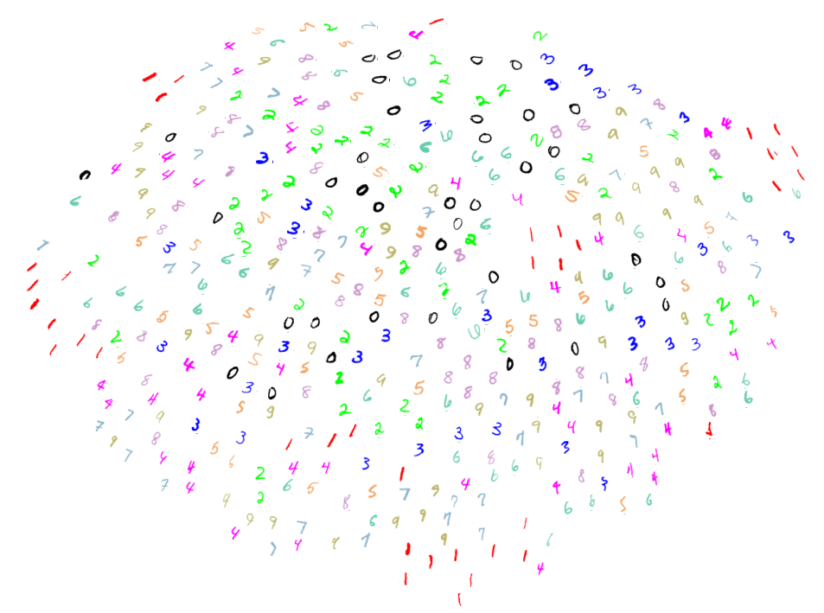
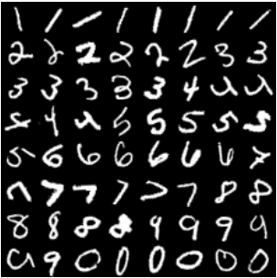
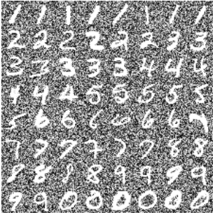
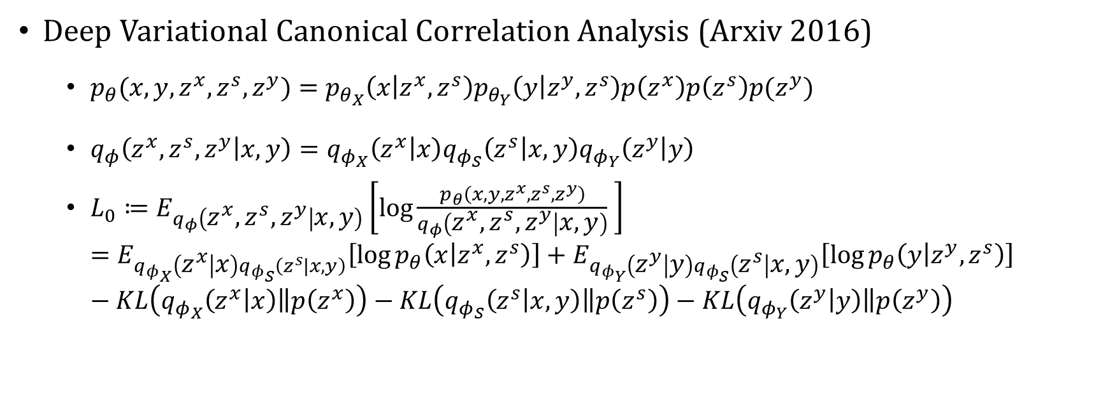




Baseline
Deep Variational Canonical Correlation Analysis (Arxiv 2016)
$p_{θ}(x,y,z^{x},z^{s},z^{y})=p_{θ_{X}}\left(x | z^{x},z^{s}\right)p_{θ_{Y}}\left(y | z^{y},z^{s}\right)p\left(z^{x}\right)p\left(z^{s}\right)p(z^{y})$
$q_{φ}\left(z^{x}, z^{s},z^{y} | x,y\right)=q_{φ_{X}}\left(z^{x} | x\right)q_{φ_{S}}\left(z^{s} | x,y\right)q_{φ_{Y}}\left(z^{y} | y\right)$
$L_{0}≔E_{q_{φ}\left(z^{x}, z^{s},z^{y} | x,y\right)}\left[\log{\frac{p_{θ}\left(x,y,z^{x},z^{s},z^{y}\right)}{q_{φ}\left(z^{x}, z^{s},z^{y} | x,y\right)}} \right]$ $=E_{q_{φ_{X}}\left(z^{x} | x\right)q_{φ_{S}}\left(z^{s}|x,y\right)}\left[\log{p_{θ}\left(x | z^{x},z^{s}\right)}\right]+E_{q_{φ_{Y}}\left(z^{y} | y\right)q_{φ_{S}}\left(z^{s} | x,y\right)}\left[\log{p_{θ}\left(y | z^{y},z^{s}\right)}\right]−KL\left(q_{φ_{X}}\left(z^{x} | x\right)\left\|p\left(z^{x}\right)\right.\right)−KL\left(q_{φ_{S}}\left(z^{s} | x,y\right)\left\|p\left(z^{s}\right)\right.\right)−KL\left(q_{φ_{Y}}\left(z^{y} | y\right)\left\|p\left(z^{y}\right)\right.\right)$
$$x$$
$$y$$
$$z^{s}$$
$$z^{x}$$

Slide 6
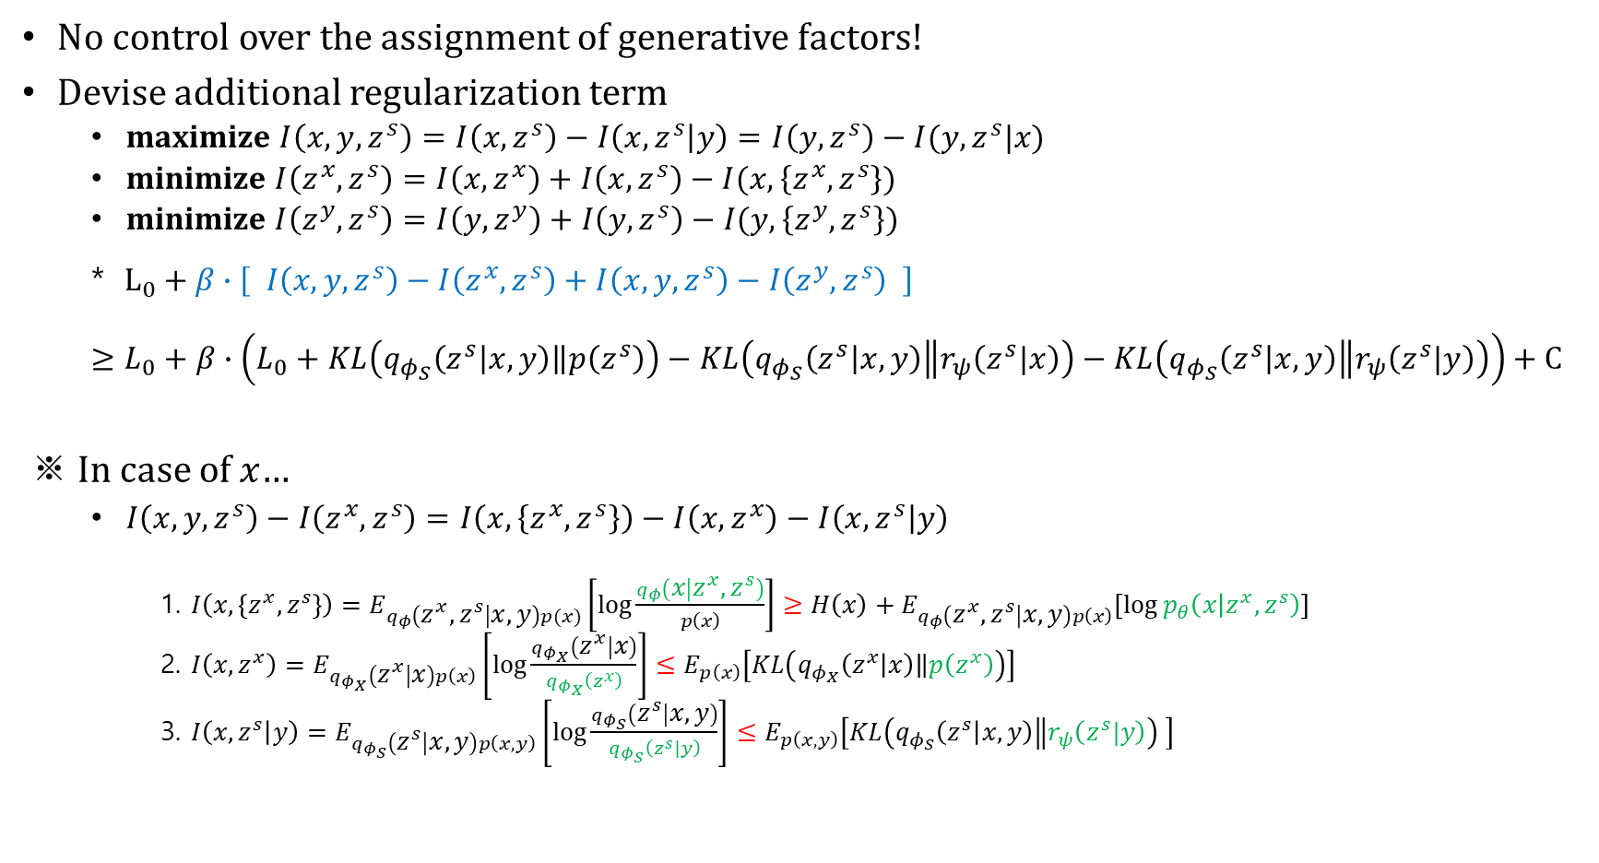
Main idea
No control over the assignment of generative factors!
Devise additional regularization term
maximize $I\left(x,y,z^{s}\right)=I\left(x,z^{s}\right)−I\left(x,z^{s} | y\right)=I\left(y,z^{s}\right)−I(y,z^{s}|x)$
minimize $I\left(z^{x},z^{s}\right)=I\left(x,z^{x}\right)+I\left(x,z^{s}\right)−I(x,\left\{z^{x},z^{s}\right\})$
minimize $I\left(z^{y},z^{s}\right)=I\left(y,z^{y}\right)+I\left(y,z^{s}\right)−I(y,\left\{z^{y},z^{s}\right\})$
* $L_{0}+β∙\left[ I\left(x,y,z^{s}\right)−I\left(z^{x},z^{s}\right)+I\left(x,y,z^{s}\right)−I\left(z^{y},z^{s}\right) \right]$ $$≥L_{0}+β∙\left(L_{0}+KL\left(q_{φ_{S}}\left(z^{s} | x,y\right)\left\|p\left(z^{s}\right)\right.\right)−KL\left(q_{φ_{S}}\left(z^{s} | x,y\right)\left\|r_{ψ}\left(z^{s}|x\right)\right.\right)−KL\left(q_{φ_{S}}\left(z^{s} | x,y\right)\left\|r_{ψ}\left(z^{s}|y\right)\right.\right)\right)+C$$
※ In case of $x$…
$I\left(x,y,z^{s}\right)−I\left(z^{x},z^{s}\right)=I\left(x,\left\{z^{x},z^{s}\right\}\right)−I\left(x,z^{x}\right)−I\left(x,z^{s} | y\right)$
1. $I\left(x,\left\{z^{x},z^{s}\right\}\right)=E_{q_{φ}\left(z^{x},z^{s} | x,y\right)p(x)}\left[\log{\frac{q_{φ}\left(x | z^{x},z^{s}\right)}{p\left(x\right)}}\right]≥H\left(x\right)+E_{q_{φ}\left(z^{x},z^{s} | x,y\right)p\left(x\right)}\left[\log{p_{θ}\left(x | z^{x},z^{s}\right)}\right]$
2. $I\left(x,z^{x}\right)=E_{q_{φ_{X}}\left(z^{x} | x\right)p\left(x\right)}\left[\log{\frac{q_{φ_{X}}\left(z^{x} | x\right)}{q_{φ_{X}}\left(z^{x}\right)}}\right]≤E_{p\left(x\right)}\left[KL\left(q_{φ_{X}}\left(z^{x} | x\right)\left\|p\left(z^{x}\right)\right.\right)\right]$
3. $I\left(x,z^{s} | y\right)=E_{q_{φ_{S}}\left(z^{s} | x,y\right)p\left(x,y\right)}\left[\log{\frac{q_{φ_{S}}\left(z^{s} | x,y\right)}{q_{φ_{S}}\left(z^{s}|y\right)}}\right]≤E_{p\left(x,y\right)}\left[KL\left(q_{φ_{S}}\left(z^{s} | x,y\right)\left\|r_{ψ}\left(z^{s}|y\right)\right.\right) \right]$

Slide 7
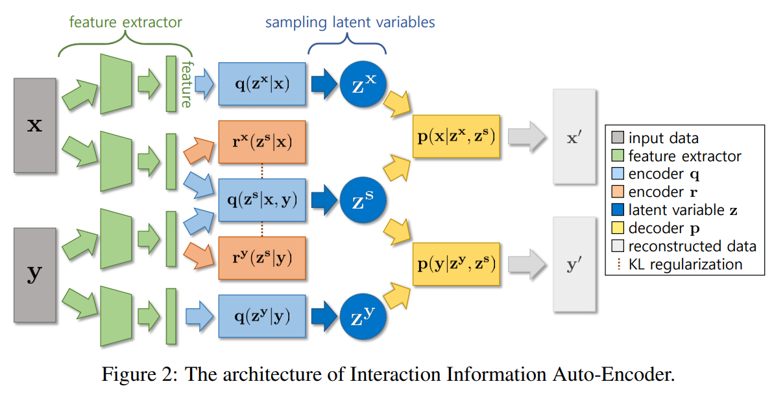

Slide 8
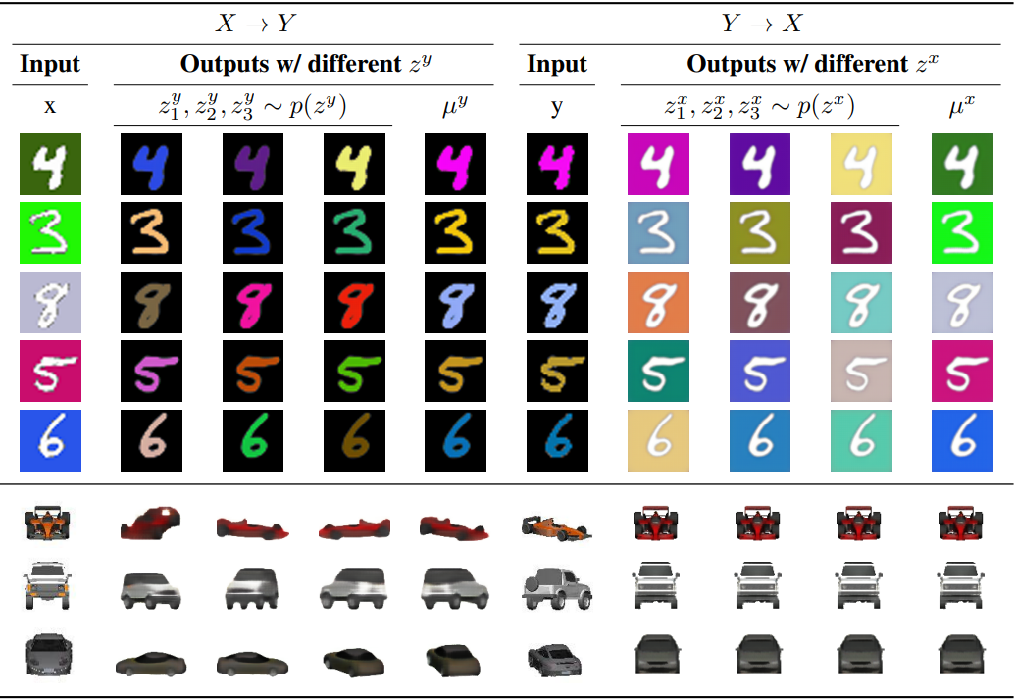
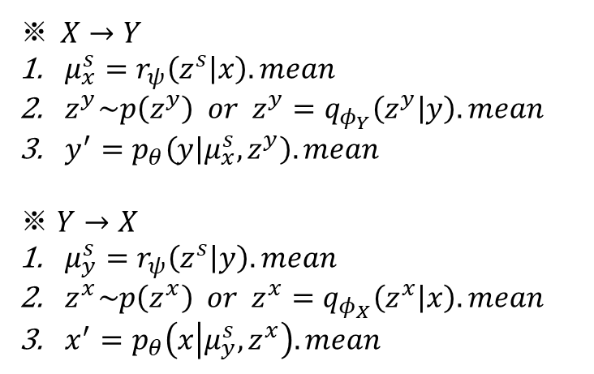
Experiment
Cross domain Image translation
MNIST-CDCB
X : variations in the background
Y : variations in the foreground
Cars
X : frontal view
Y : rotated view
※ $X→Y$
$μ_{x}^{s}=r_{ψ}\left(z^{s} | x\right).mean$
$z^{y}\sim p\left(z^{y}\right) or z^{y}=q_{φ_{Y}}\left(z^{y} | y\right).mean$
$y^{′}=p_{θ}\left(y | μ_{x}^{s},z^{y}\right).mean$
※ $Y→X$
$μ_{y}^{s}=r_{ψ}\left(z^{s} | y\right).mean$
$z^{x}\sim p\left(z^{x}\right) or z^{x}=q_{φ_{X}}\left(z^{x} | x\right).mean$
$x^{′}=p_{θ}\left(x | μ_{y}^{s},z^{x}\right).mean$

Slide 9
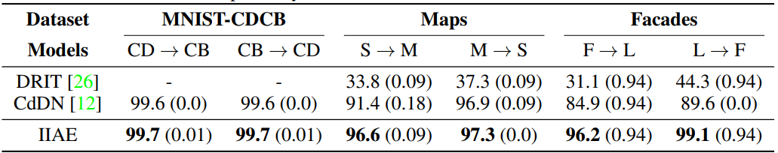
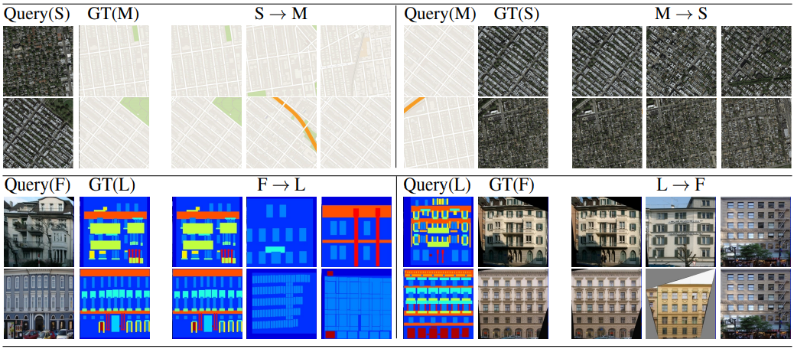
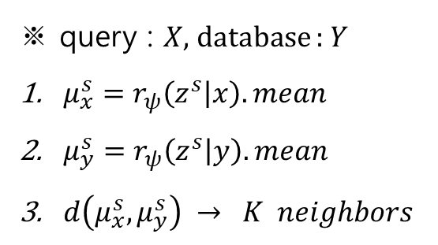
Experiment
Cross domain retrieval
Maps
X : map image
Y : satellite image
Facades
X : semantic label map
Y : photo of the same building
※ query : $X$, database : $Y$
$μ_{x}^{s}=r_{ψ}\left(z^{s} | x\right).mean$
$μ_{y}^{s}=r_{ψ}\left(z^{s} | y\right).mean$
$d\left(μ_{x}^{s},μ_{y}^{s}\right) → K neighbors$

Slide 10
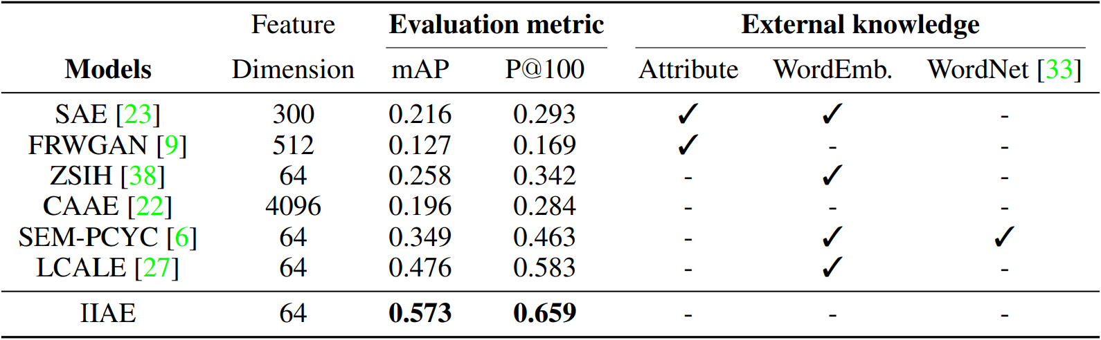
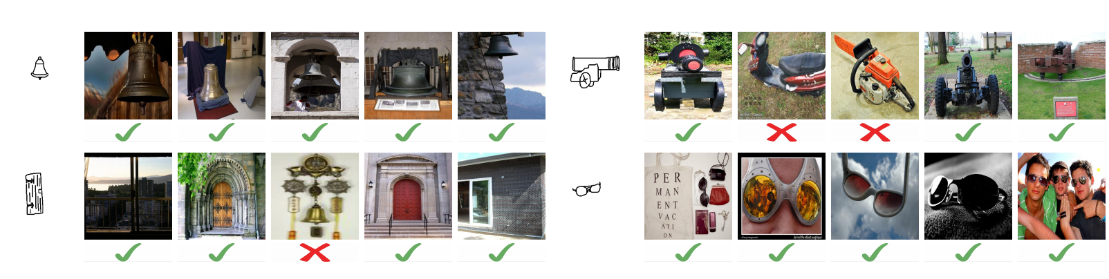
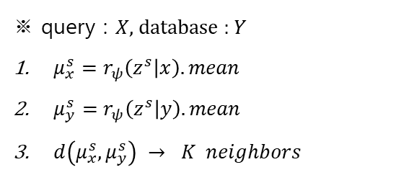
Experiment
Zero-shot sketch based image retrieval
Sketchy(extended)
X : sketches
Y : photos
※ query : $X$, database : $Y$
$μ_{x}^{s}=r_{ψ}\left(z^{s} | x\right).mean$
$μ_{y}^{s}=r_{ψ}\left(z^{s} | y\right).mean$
$d\left(μ_{x}^{s},μ_{y}^{s}\right) → K neighbors$

Slide 11
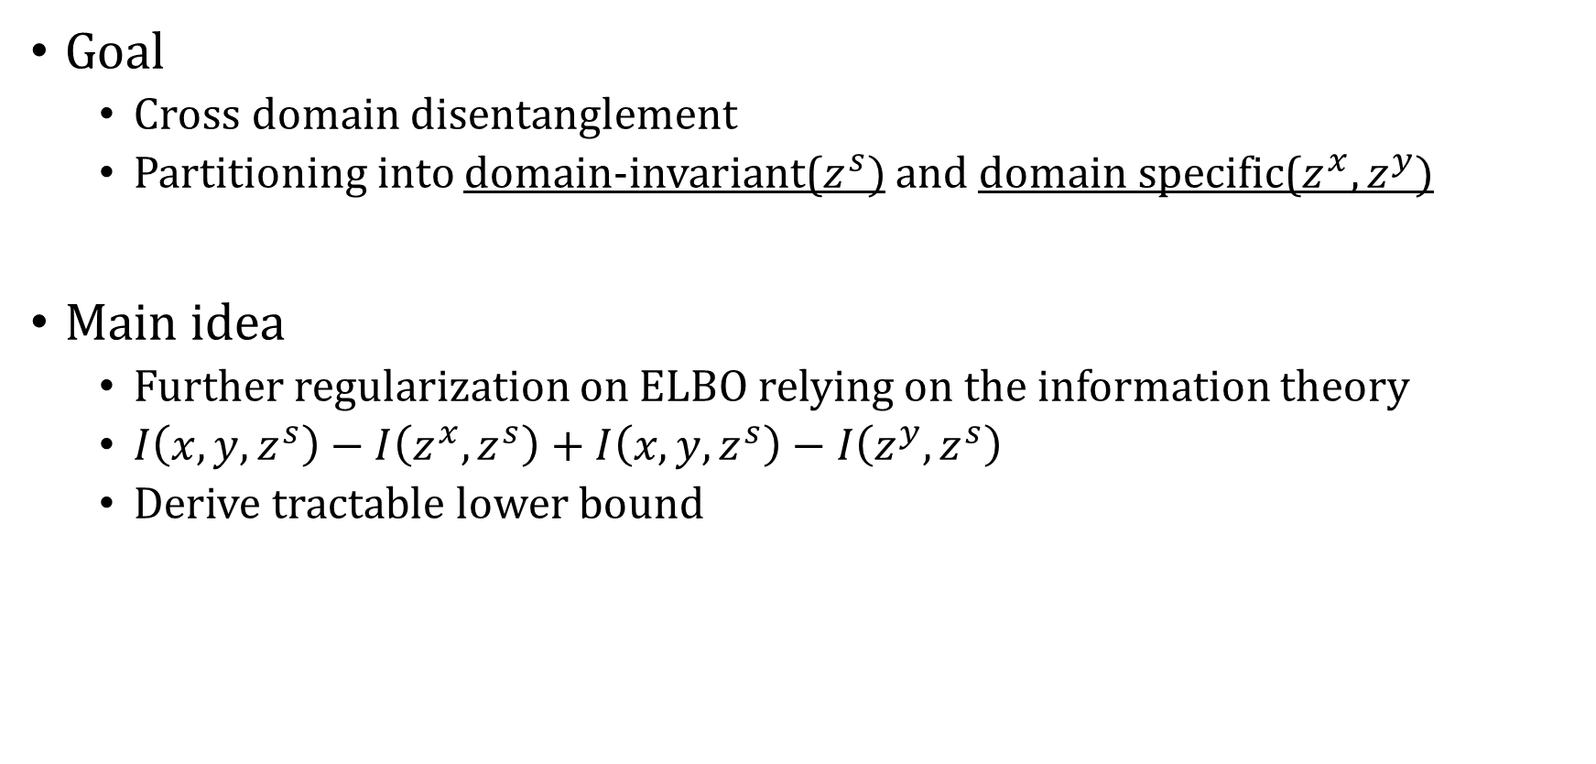
Summary
Goal
Cross domain disentanglement
Partitioning into domain-invariant($z^{s})$ and domain specific($z^{x}, z^{y})$
Main idea
Further regularization on ELBO relying on the information theory
$I\left(x,y,z^{s}\right)−I\left(z^{x},z^{s}\right)+I\left(x,y,z^{s}\right)−I\left(z^{y},z^{s}\right)$
Derive tractable lower bound

